Slide 1


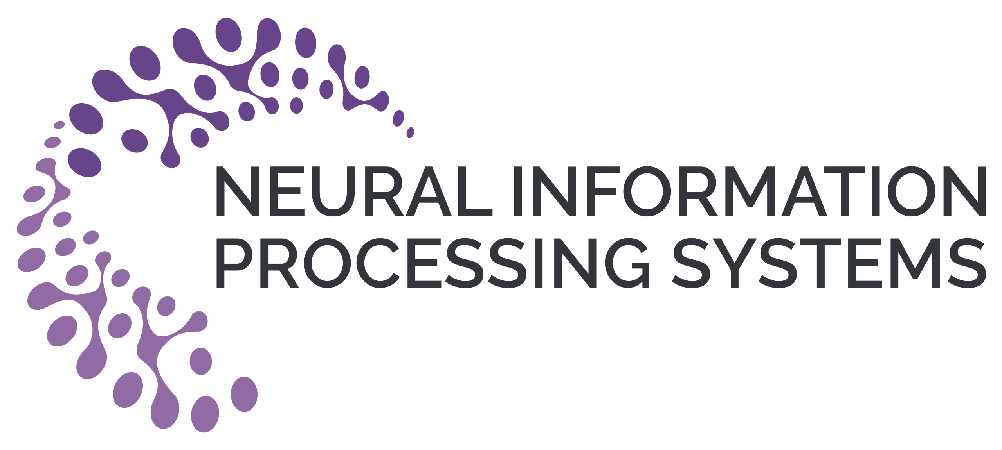
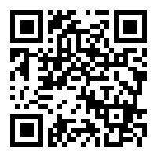


Zero-Shot Video Question Answering via Frozen Bidirectional Language Models
Antoine Yang^{1,2}, Antoine Miech³, Josef Sivic⁴, Ivan Laptev^{1,2}, Cordelia Schmid^{1,2}
¹Inria Paris ²Ecole Normale Supérieure, PSL ³DeepMind ⁴CIIRC, CTU in Prague
Overview
Architecture
BiLM vs Autoregressive LM
Ablation studies
Zero-Shot VideoQA
Method | Params | iVQA | MSRVTT-QA | MSVD-QA | ActivityNet-QA | TGIF-QA
Autoregressive (GPT-J) | 6B | 21.4 | 9.6 | 26.7 | 24.5 | 37.3
Bidirectional (BERT-Base) | 110M | 12.4 | 6.4 | 11.7 | 16.7 | 23.1
Bidirectional (DeBERTa-V2-XLarge) | 890M | 27.3 | 16.8 | 32.2 | 24.7 | 41.0
➤ Freezing the BiLM helps (+7.6% acc. on TVQA, 2x faster training)
➤ Adapters help (+5.8% acc. on TVQA)
➤ Vision helps (+13.6% acc. on iVQA) and speech helps (+29.5% acc. on TVQA)
➤ Scaling WebVid from 10K to 10M samples helps (+11.1% acc. on MSVD-QA)
➤ Scaling the BiLM from BERT-Base to the 900M param DeBERTa-XLarge helps (+14.8% acc. on iVQA)
➤ Answer questions about videos without training on manual annotation of visual data.
Motivation
➤ A strong approach relies on frozen autoregressive language models [1] but requires large models.
➤ Recent work in natural language [2] shows strong zero-shot results with lighter bidirectional masked language models (BiLM).
Comparison to SoTA
➤ Zero-shot results.
Method | LSMDC | iVQA | MSRVTT-QA | MSVD-QA | ActivityNet-QA | TGIF-QA | How2QA | TVQA
SoTA | 31.0 [5] | 13.3 [4] | 5.8 [5] | 13.5 [4] | 12.3 [4] | 3.6 [3] | 53.1 [4] | 26.1 [3]
FrozenBiLM | 51.5 | 26.8 | 16.7 | 33.8 | 25.9 | 41.9 | 58.4 | 59.7
➤ Frozen parameters: pretrained BiLM and visual backbone.
➤ Trained parameters: visual-to-text projection, adapters, layer norm.
Contributions
➤ FrozenBiLM: a framework that handles multi-modal inputs using frozen BiLM and enables zero-shot VideoQA through masked language modeling.
➤ Extensive ablation studies and improvements over previous autoregressive models.
➤ SoTA on 8 zero-shot benchmarks, competitive performance on fully-supervised benchmarks and promising few-shot results.
➤ Code and models: https://github.com/antoyang/FrozenBiLM
Cross-modal Training
➤ Loss: visually-conditioned masked language modeling.
➤ Data: videos with alt-text description from WebVid10M.
Downstream Task Adaptation
➤ Fully-supervised benchmarks. Note that FrozenBiLM only trains 30M parameters.
➤ Input prompts:
Open-ended VideoQA: “[CLS] Question: <Question>? Answer: [MASK]. Subtitles: <Subtitles> [SEP]”
Multiple-choice VideoQA: “[CLS] Question: <Question>? Is it ’<Answer Candidate>’? [MASK]. Subtitles: <Subtitles> [SEP]”
Video-conditioned fill-in-the-blank: “[CLS] <Sentence with a [MASK] token>. Subtitles: <Subtitles> [SEP]”
➤ Answer embedding module: maps a masked token to an answer using the frozen masked language modeling head.
➤ Fully-supervised finetuning: standard cross-entropy loss while keeping the same weights frozen.
Method | LSMDC | iVQA | MSRVTT-QA | MSVD-QA | ActivityNet-QA | TGIF-QA | How2QA | TVQA
SoTA | 53.7 [6] | 35.4 [4] | 46.8 [7] | 48.3 [7] | 41.4 [8] | 69.5 [8] | 85.3 [4] | 86.1 [5]
FrozenBiLM | 63.5 | 39.6 | 47.0 | 54.8 | 43.2 | 68.6 | 86.7 | 82.0
Few-Shot results
➤ New setting using a small fraction of the downstream dataset for finetuning.
References
Supervision | LSMDC | iVQA | MSRVTT-QA | MSVD-QA | ActivityNet-QA | TGIF-QA | How2QA | TVQA
0% (zero-shot) | 51.5 | 26.8 | 16.7 | 33.8 | 25.9 | 41.0 | 58.4 | 59.7
1% (few-shot) | 56.9 | 31.1 | 36.0 | 46.5 | 33.2 | 55.1 | 71.7 | 72.5
10% (few-shot) | 59.9 | 35.3 | 41.7 | 51.0 | 37.4 | 61.2 | 75.8 | 77.6
100% (fully-supervised) | 63.5 | 39.6 | 47.0 | 54.8 | 43.2 | 68.6 | 86.7 | 82.0
[1] M. Tsimpoukelli et al., Multimodal few-shot learning with frozen language models. In NeurIPS 2021.
[2] T. Shick, et. al., It’s not just size that matters: small language models are also few-shot learners. In NAACL 2021.
[3] A. Radford, et. al., Learning transferable visual models from natural language supervision. In arXiv, 2021.
[4] A. Yang, et. al., Learning to answer visual questions from Web videos. In TPAMI, 2022..
[5] R. Zellers, et. al., Merlot reserve: neural script knowledge through vision, language and sound. In CVPR, 2022.
[6] TJ. Fu et al., Violet: end-to-end video-language transformers with masked visual token modeling. In arXiv 2021.
[7] AJ. Wang et al, All in one: exploring unified video-language pretraining. In arXiv 2022.
[8] R. Zellers et al. Merlot: multi-modal neural script knowledge models. In NeurIPS 2021.

